Slide 1
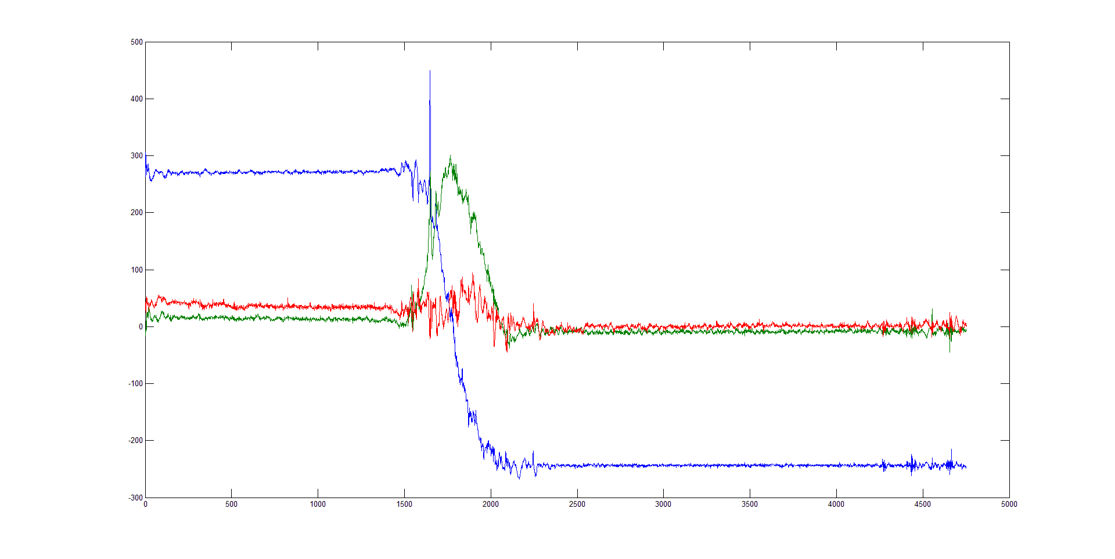
Axis oriented parallel to gravity
Axis oriented anti-parallel to gravity

